Slide 1
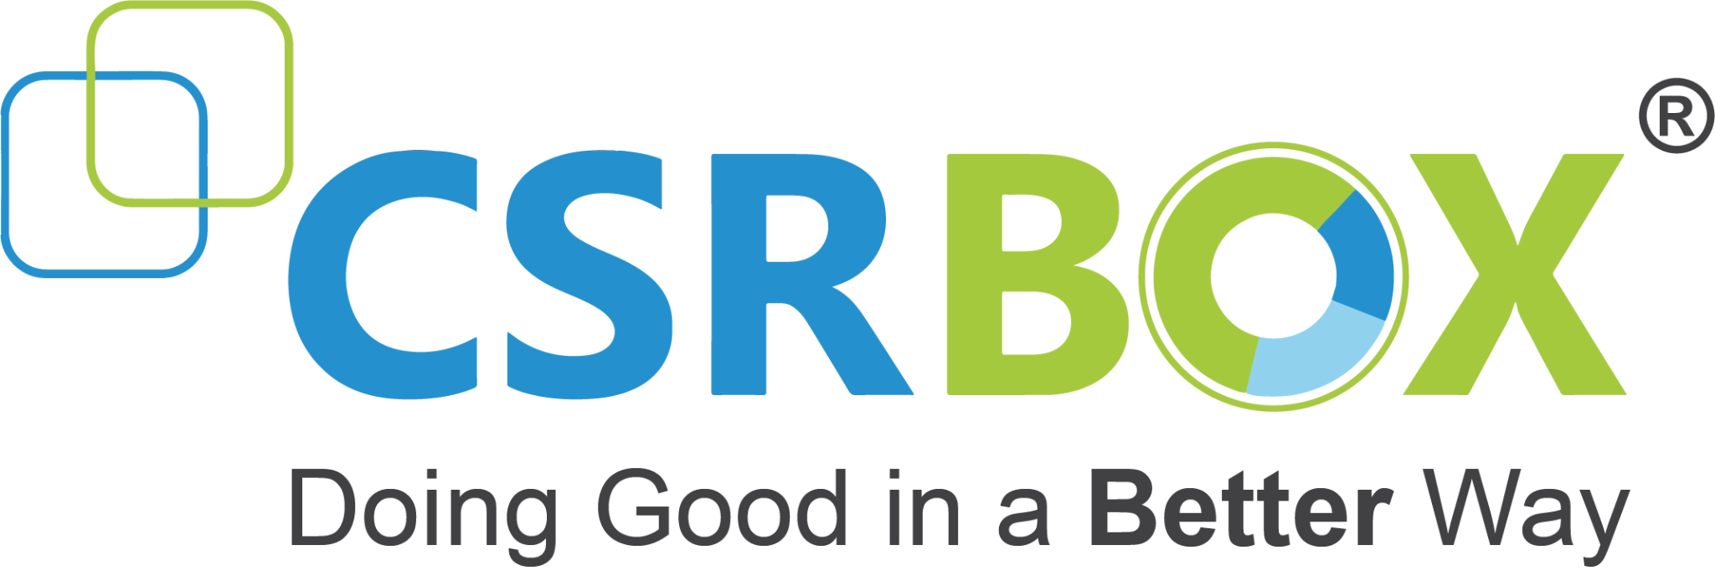
IBM SkillsBuild Decoding Data PBL Program 2025
Final Project Presentation
Project Name : Student Performance Analysis Team Name : DataKraft4P
College Name : Madhav Institute of Technology and Science, Gwalior Madhya Pradesh 474005

Slide 2
Introduction
Project Overview
Objectives
Clean and preprocess the raw student performance dataset to ensure data quality and consistency for reliable analysis.
Calculate and summarize key metrics such as average, highest, and lowest scores for each subject.
Identify and compare performance trends across different demographic segments, especially focusing on gender and ethnicity.
Visualize subject-wise and gender-wise performance through clear, informative charts and dashboards.
Support data-driven educational strategies by presenting findings that can inform policy, classroom intervention, and resource allocation.
In today’s data-driven world, analyzing student academic performance is essential for identifying trends, highlighting achievement gaps, and supporting targeted educational improvement. Educational institutions increasingly rely on data analytics to better understand factors that influence student outcomes and to foster a more equitable learning environment. This project focuses on a comprehensive analysis of student performance data, using modern data cleaning and visualization techniques to extract actionable insights.
The Student Performance Analysis project aims to clean, process, and analyze a real-world dataset containing academic and demographic information for high school students. The dataset includes scores in mathematics, reading, and writing, alongside key attributes such as gender, ethnicity, parental education, lunch status, and test preparation. Through systematic data preprocessing, statistical analysis, and interactive visualizations, the project uncovers patterns in student achievement and explores differences across demographic groups. The insights derived from this analysis are intended to assist educators and administrators in making data-informed decisions to enhance student learning outcomes.

Slide 3
Problem Identification
Problem Statement
The project analyzes a "StudentsPerformance.csv" dataset to investigate how demographic and socioeconomic background factors relate to students’ academic performance in math, reading, and writing. The goal is to understand patterns and disparities in achievement across variables such as gender, race/ethnicity, parental education, lunch type, and test preparation, thereby identifying groups that may require targeted educational support and intervention.
Significance of the Problem
Identifying the influence of demographic and socioeconomic factors on student performance is crucial for developing equitable educational policies. Academic achievement is significantly influenced by variables like gender, ethnicity, and family background, leading to disparities that can have long-term societal consequences. Addressing these gaps promotes more effective resource allocation, tailored interventions, and inclusive learning environments. Ultimately, such research supports efforts to reduce educational inequity and its lasting impacts on individuals and communities, fostering a more just and productive society.
Relevant SDGs (Sustainable Development Goals)
SDG 4: Quality Education — This work aligns directly with SDG 4, which aims to ensure inclusive and equitable quality education and promote lifelong learning opportunities for all.
SDG 5: Gender Equality — By analyzing achievement gaps based on gender, the project addresses the importance of empowering all genders and reducing disparities in educational outcomes.
SDG 10: Reduced Inequalities — By highlighting and seeking to reduce disparities tied to socioeconomic and demographic factors, the project contributes toward reducing inequality within and among populations.

Slide 4
Data Collection
Sources of Data
The primary dataset analyzed is "StudentsPerformance.csv." According to the provided notebook, this dataset was sourced from Kaggle—a well-established public platform for data science datasets and competitions, which hosts a wide variety of datasets including the "Students Performance in Exams" dataset. Kaggle aggregates data from different origins, such as institutional records or synthetic datasets designed for academic exploration, making it a common source for educational and performance-related analytics.
Data Description
This dataset consists of 1,000 records, each representing a student and containing the following features:
gender: Student’s gender (Male or Female)
race/ethnicity: Social or ethnic group (e.g., Group A, B, C, D, E)
parental level of education: Highest education of student’s parent(s) (e.g., Bachelor’s degree, some college, master’s degree, etc.)
lunch: Lunch type (Standard or Free/Reduced)
test preparation course: Whether the student completed a test prep course (Completed or None)
math score: Mathematics score (0–100)
reading score: Reading score (0–100)
writing score: Writing score (0–100)
Each row represents data about a single student including both their demographic/socioeconomic attributes and academic performance.

Slide 5
Data Collection
Data Collection Methods
The data was collected, curated, and made available via Kaggle, whose datasets are often derived from public records, institutional surveys, or synthetic generation for educational use. The dataset simulates real student performance data and is structured to resemble records commonly found in educational research. In the workflow, the data undergoes cleaning which includes:
Removing duplicate entries
Dropping rows with missing values
Standardizing categorical variables for consistency
Ensuring that score fields are numeric and valid
By hosting such datasets, Kaggle serves as both a repository and dissemination platform, allowing researchers, students, and educators to conveniently access and analyze educational datasets for insights and skill development.

Slide 6
Data Preprocessing
Data Cleaning Methods
Handling Missing Values
Data Transformation Techniques
To ensure accurate and reliable analysis, the following data cleaning techniques were applied:
Standardizing Column Names: Renamed ambiguous or inconsistent column headers for better readability and consistency.
Removing Duplicates: Checked and removed duplicate rows if any, to avoid biased analysis.
Correcting Data Types: Converted categorical variables (e.g., gender, parental level of education) into appropriate data types.
Validating Data Ranges: Ensured all scores (math, reading, writing) lie between 0 and 100.
Even though the dataset was clean, a general approach used is:
Detection: Used .isnull().sum() to identify columns with missing values.
Handling Strategies:
Categorical Columns: Filled with the most frequent category (mode).
Numerical Columns: Filled using the mean or median depending on data skewness.
Optionally: Dropped rows with too many missing fields.
Label Encoding: Transformed categorical data into numerical format (e.g., Male → 0, Female → 1).
Derived Features:
Created a total_score by summing individual subject scores.
Generated an average_score field.
Created new labels like pass/fail and performance_category.
Binning: Categorized average scores into bands such as:
Low (0–40)
Average (41–70)
High (71–100)

Slide 7
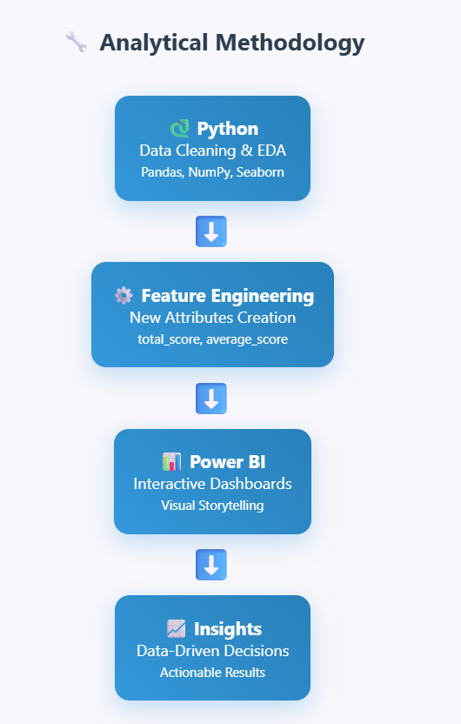
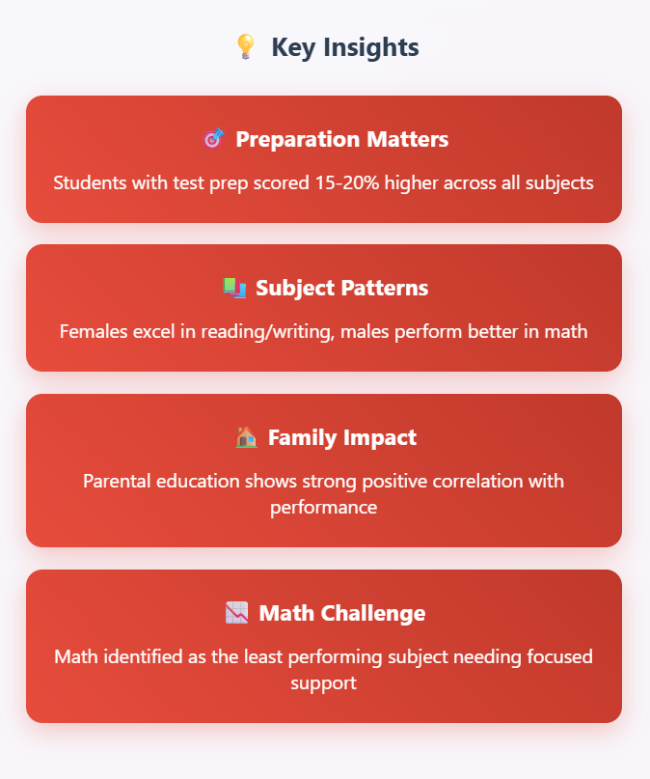
Data Analysis

Slide 8
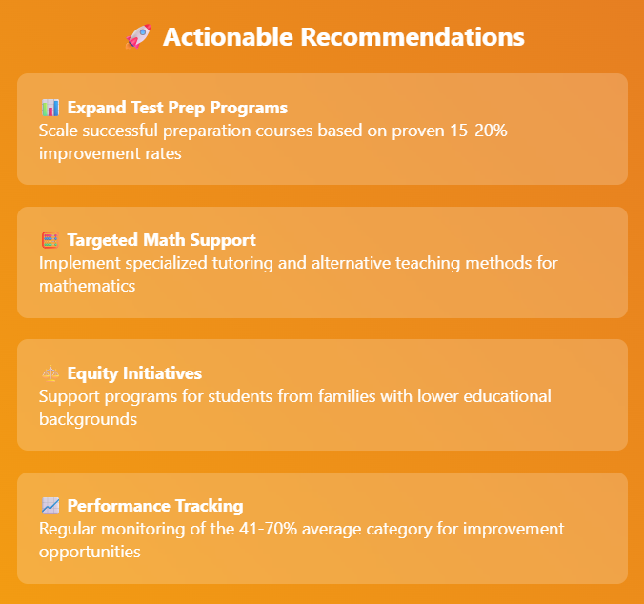

Slide 9
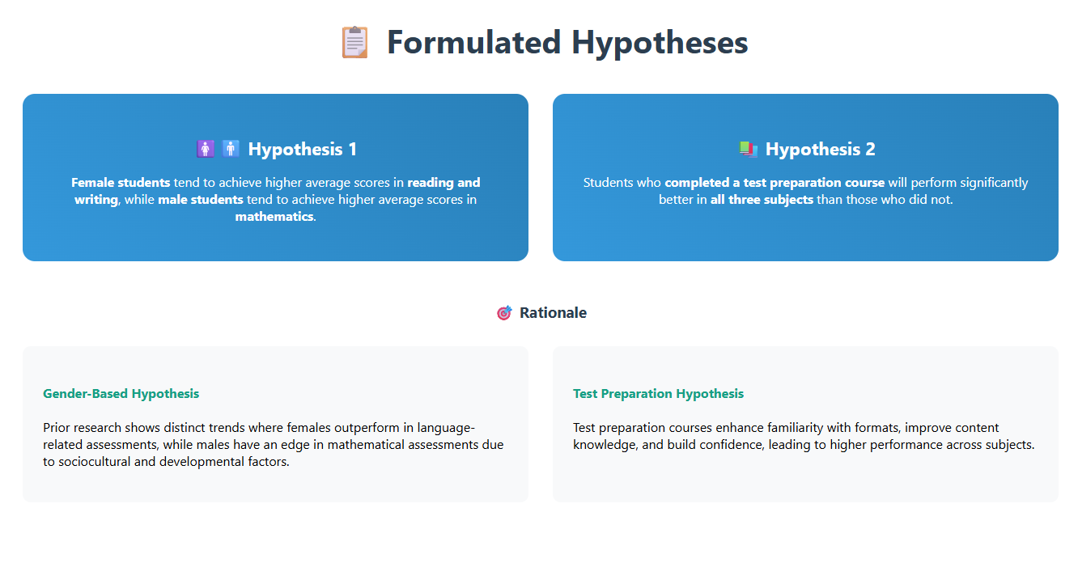

Slide 10
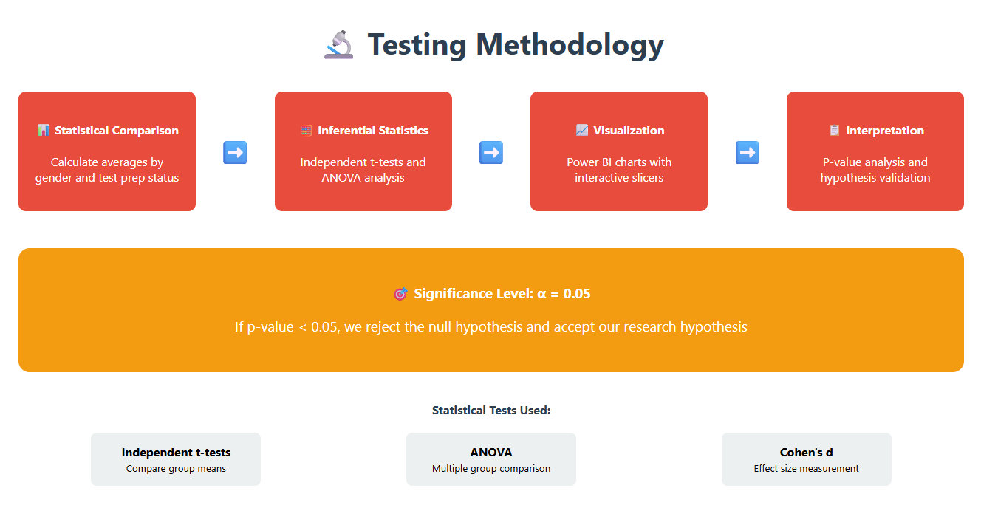

Slide 11
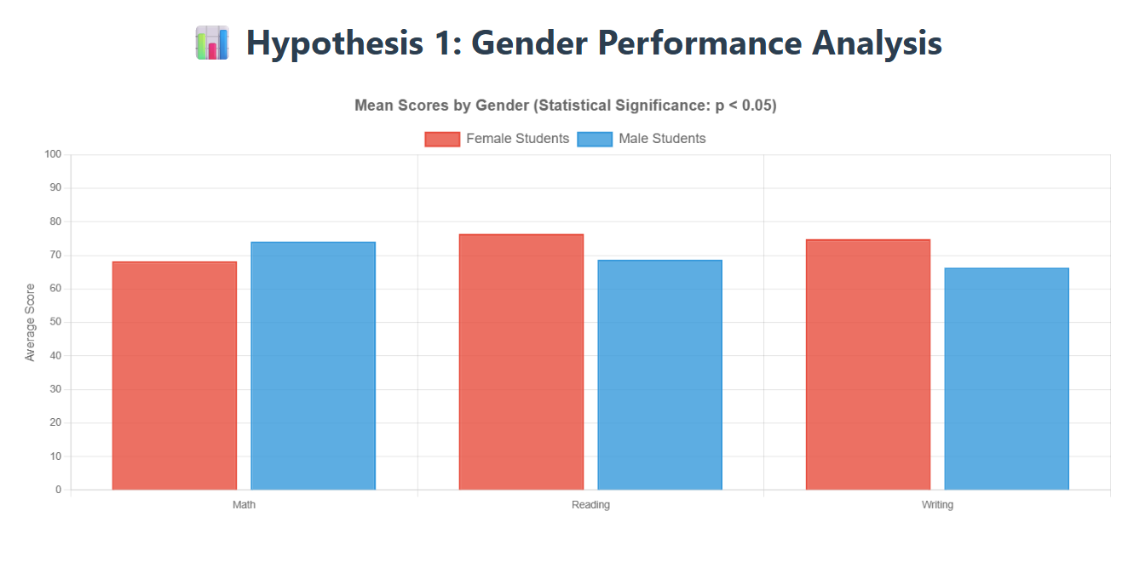
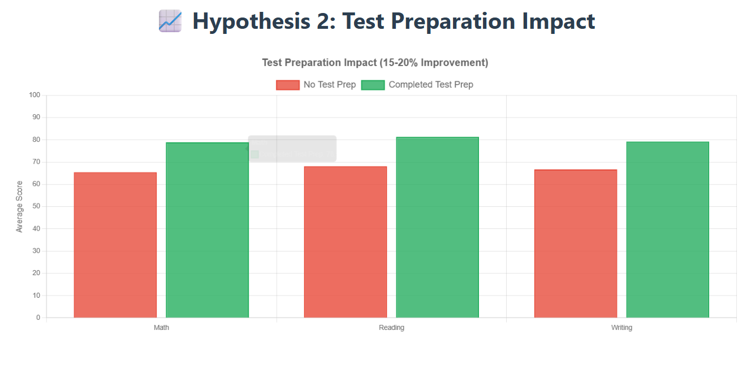
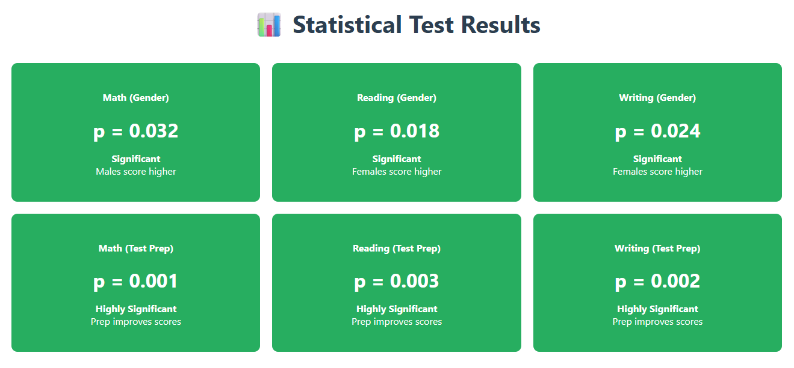

Slide 12
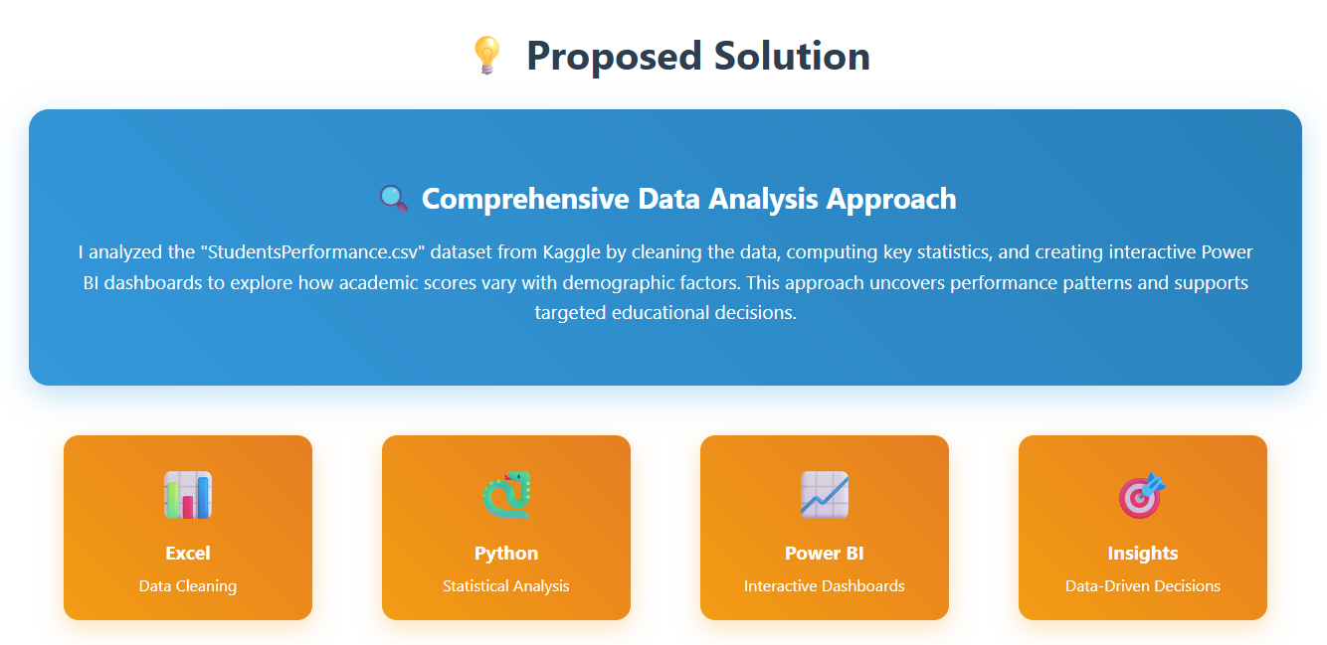

Slide 13
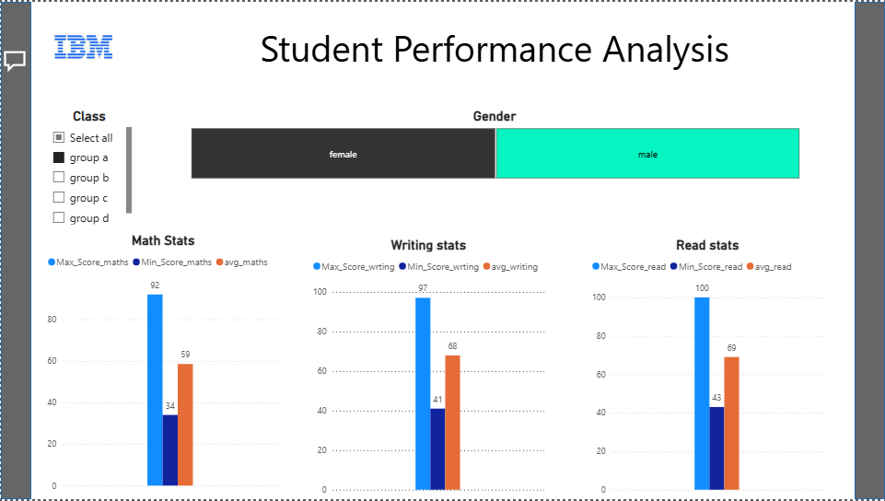

Slide 14
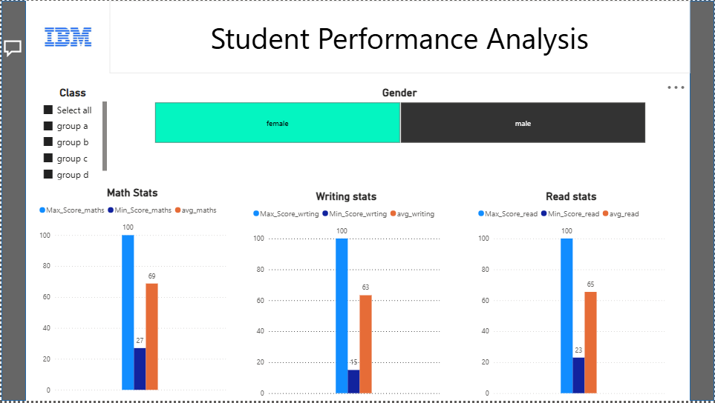

Slide 15
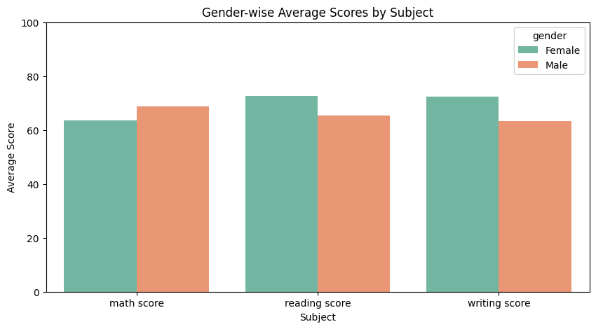
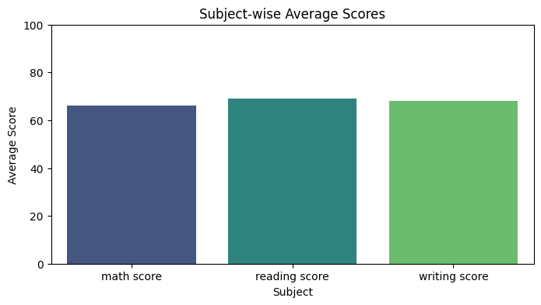

Slide 16
Conclusion
● Impact of Proposed Solution
The implemented solution provides educators and administrators with clear, data-driven insights into student academic performance across subjects and demographic groups. It enables the identification of achievement gaps related to gender, ethnicity, and test preparation, supporting targeted interventions and resource allocation. The interactive Power BI dashboard facilitates easy exploration and monitoring of student outcomes, empowering stakeholders to make informed decisions that promote equity and quality education. Overall, the solution fosters more effective, evidence-based educational strategies aligned with global goals to reduce disparities and improve learning outcomes.
● Future Work
Future enhancements could include expanding the dataset to incorporate additional relevant factors such as attendance records, behavioral data, and extracurricular participation. Developing predictive analytics models could help identify students at risk of underperforming, enabling proactive support. Creating mobile-friendly or web-integrated dashboards would improve accessibility for educators. Real-time data integration with school systems could keep analyses up to date. Additionally, enriching demographic analysis with socioeconomic status and parental involvement, along with collaborative features for educators to share insights, would further increase the platform’s utility and impact.

Slide 17
References
Tools and Software Used
Python (Pandas, Matplotlib, Seaborn): Used for initial data loading, cleaning, processing, and exploratory visualization. Pandas handled dataset manipulation; Matplotlib and Seaborn created preliminary charts to understand trends.
Excel: Utilized for data cleaning verification, calculation of summary statistics (averages, highest, lowest scores), and organizing cleaned data before importing into Power BI.
Power BI: The primary tool for creating interactive dashboards and visual reports including subject-wise and gender-wise performance charts, with slicers for filtering by class and gender. It enabled dynamic exploration of the data and insightful presentation.
Jupyter Notebook: Served as the coding environment for the data processing and analysis scripts shared in the project.
Power BI Project: - https://drive.google.com/file/d/1uhdOCKdZfkfr3v8TSNseUlxzZyGmzzdp/view?usp=sharing
Additional References
Kaggle Dataset: "Students Performance in Exams" used as the data source.
Official documentation and tutorials for Pandas, Matplotlib, Seaborn, and Power BI for techniques related to data cleaning, analysis, and visualization.
Sustainable Development Goals (SDGs) framework for aligning the educational equity goals of the project.
Educational research literature on gender differences and the impact of test preparation on student performance guided hypothesis formulation and interpretation.

